Slide 1
Intrusion Detection System (IDS)
Gaurav Agarwal (20BCS047)
Amit Prakhar Pandey (20BCS012)
Harsh Rawat (20BCS050)
Ashis J Kalathil (20BCS022)

Slide 2
INDEX
What is IDS
Brim
Tools Used
DNS DDoS Amplification Attack
Zeek
Future Goals
Zeek’s Architecture
Zeek v/s any other network analysis frameworks

Slide 3
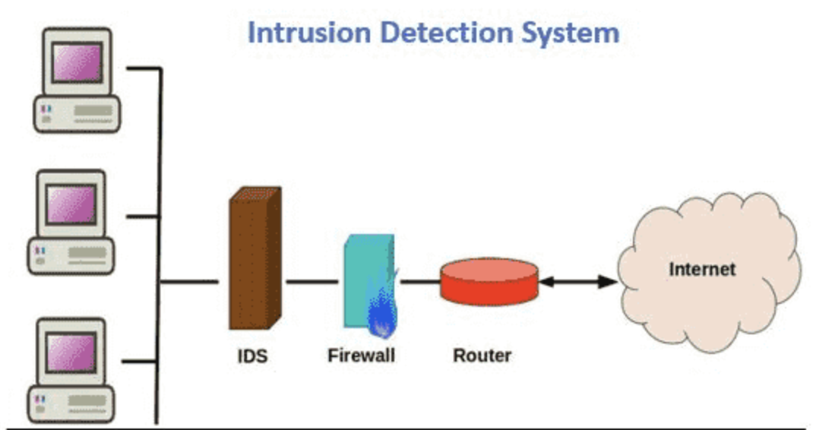
What is IDS ?
IDS is an abbreviation for Intrusion Detection System, which is a type of software or hardware system used to monitor network traffic or system events for security threats.
IDS can be host-based or network-based, with host-based systems monitoring a single computer or server, and network-based systems monitoring traffic passing through a specific point in a network.
IDS can detect a wide range of threats, such as unauthorized access attempts, malware infections, data exfiltration, and more.

Slide 4
Purpose
Protecting against external threats
Protecting against internal threats
Early detection of potential threats
Minimizing damage and data loss
Enhancing incident response capabilities
Monitoring and auditing network activity

Slide 5
AIM Of The Project
Create a Zeek Script that can analyse the packet

Slide 6
Tools Used:
Zeek
Brim

Slide 7

What is Zeek?
Zeek is a passive, open-source network traffic analyzer. It is primarily used as a security monitor that inspects all traffic on a network link for signs of suspicious activity. It can run on commodity hardware with standard UNIX-based systems and can be used as a passive network monitoring tool.

Slide 8
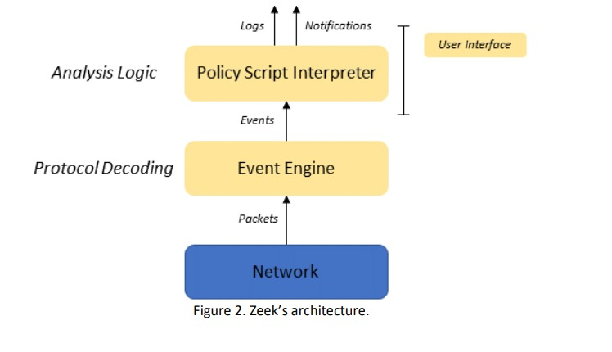
Zeek’s Architecture

Slide 9
Features of Zeek
Network traffic analysis
Protocol analysis
Threat detection
Forensic analysis
Integration with other security tools
Customization and extensibility

Slide 10
Zeek v/s any other network analysis framework
Zeek excels at protocol analysis, making it ideal for complex threats.
Its customizability with Zeek Script allows for tailored security solutions.
Zeek is open source, free, and has a strong developer community.
It has a steeper learning curve than some other IDS software.
Zeek is best suited for advanced users or complex network environments.

Slide 11

Brim
Brim is a data analysis and visualization tool designed for large-scale datasets.
Brim allows users to search and analyze data from various sources, including network traffic, log files, and other machine-generated data.
Brim uses a columnar data store to enable fast searching and filtering of large datasets.
Brim's interface is designed to be user-friendly, with advanced search capabilities and real-time visualizations of data.

Slide 12
Features of Brim
Log management
Visualization and analysis
Advanced querying
Security analytics
Collaboration and sharing
Integration with other security tools

Slide 13
What We Had Done Till Now
Set up an IDS with Filebeat Log Shipping
How to use Zeek for Pcap analysis
Suspected Malware Compromise
DNS DDoS Attack

Slide 14
DNS DDoS Amplification Attack
DNS amplification is a Distributed Denial of Service (DDoS) attack in which the attacker exploits vulnerabilities in domain name system (DNS) servers to turn initially small queries into much larger payloads, which are used to bring down the victim’s servers.

Slide 15
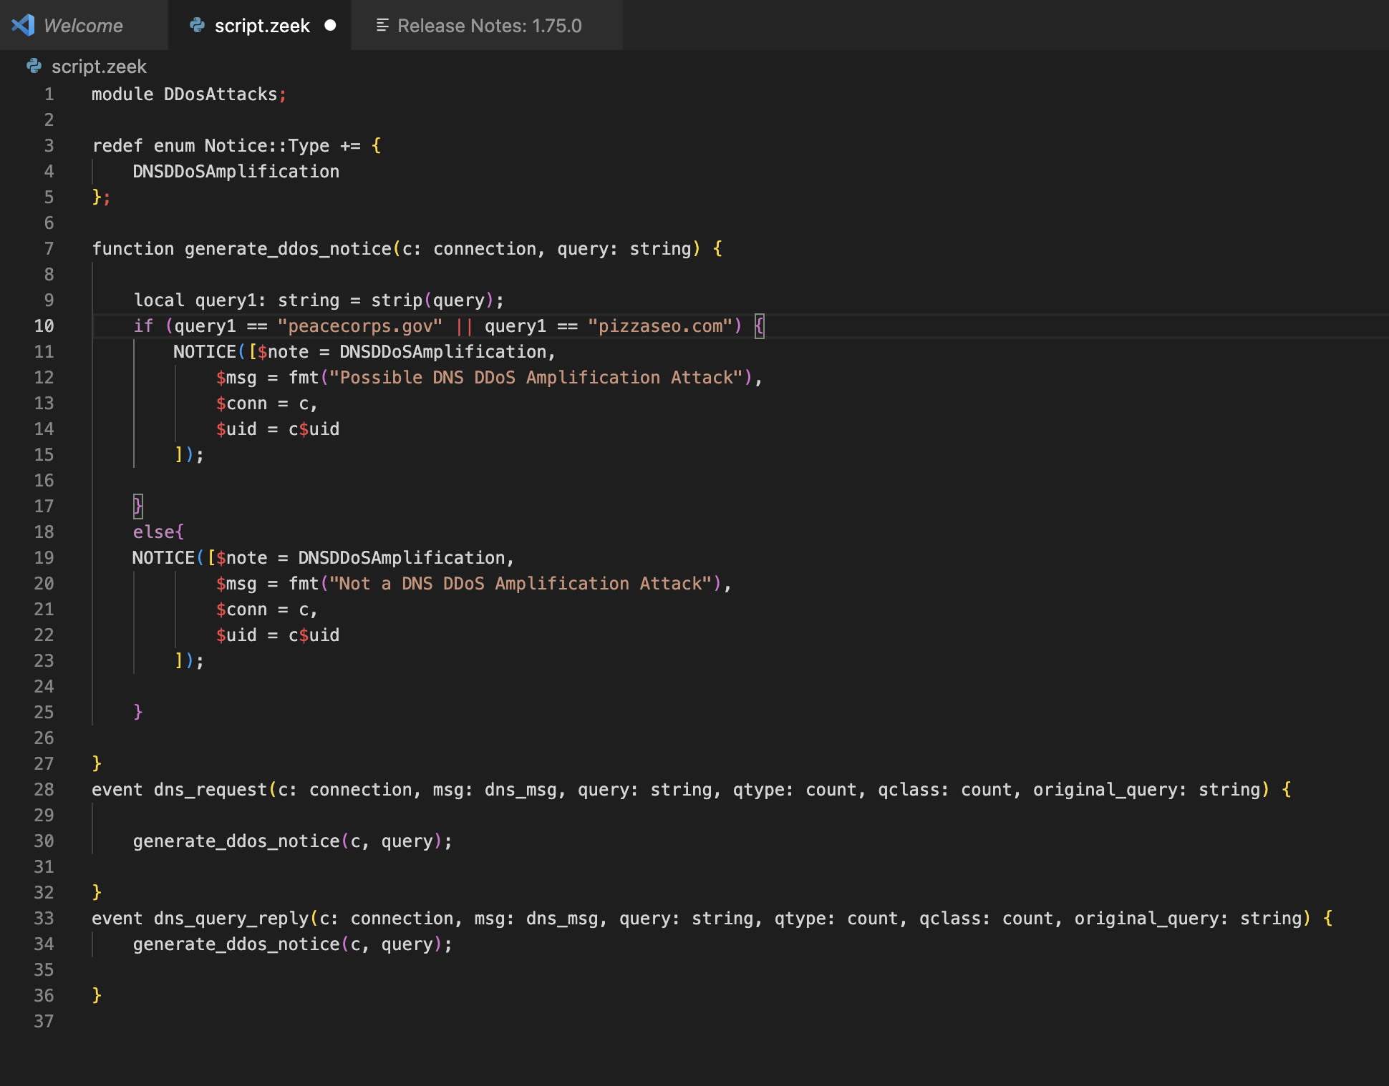
Zeek Script

Slide 16
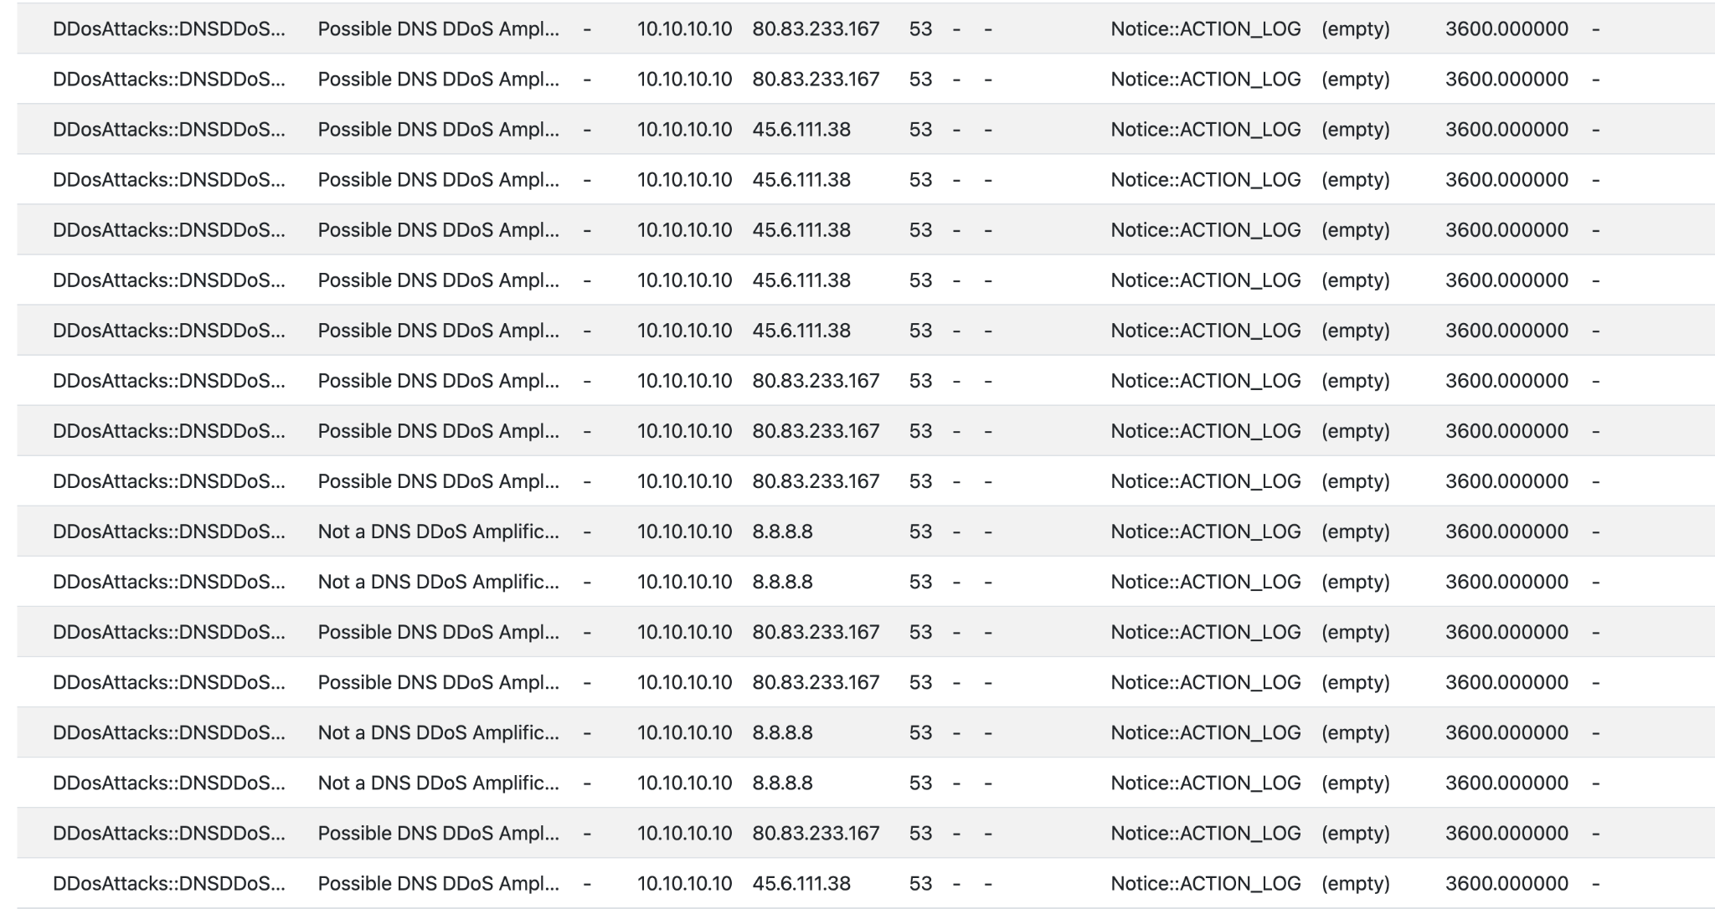
Notice File

Slide 17
Future Goals
Zeek Scripting for analysing various other complex attacks
Visualizing the patterns of packets using Brim
Integrating various other network analysing tools like Surikata

Slide 18
References
https://medium.com/itsecasia-research/zeek-script-example-for-detecting-dns-ddos-attack-6f64a430b14a
https://youtu.be/xpPEHtACrek
http://ce.sc.edu/cyberinfra/docs/workshop/Zeek_Lab_Series.pdf
https://zeek.org/
https://www.malware-traffic-analysis.net/

Slide 19
Thank You

